Slide 1



Value types, validation rules
and data set completion
Data Capture & Validation

Slide 2



Data quality
How can you check data quality when you are entering data in DHIS2?
Notes:
Ensuring good data quality is essential for data-driven decision-making. So how can you check data quality when you are entering data in DHIS2?

Slide 3






In this video, you will see…
Data entry
Data quality
Value types
Validation rules
Complete button
Notes:
Earlier in this course, you saw some of the ways that the data entry app provides helpful feedback during the data entry process. In this video, you will learn more about how value types, validation rules, and completing your data set can be used to assist with data quality.

Slide 4
Value types in data entry
Data entry
Value types
Notes:
First, let's look at value types in data entry.

Slide 5


Value types in data entry
Data entry
Value types
#
≥0
18
/
Notes:
DHIS2 checks any value entered to see if it matches the value type set for that data element.

Slide 6
Some value types in DHIS2
Value types
#
Number
453.32
≥0
Positive or Zero integer
5
Date
August 27th
18
/
Yes/No
Yes
Notes related to facility assessment
Text
Notes:
There are many possible value types for data elements in DHIS2, but some common ones are number, positive or zero integer, date, yes/no, and text. These value types are defined when creating data elements.

Slide 7

Data entered needs to match the value type
#
Number
11/02/2022
Error
Notes:
If data entered for a data element does not match the value type, the data will not be stored and you will get an error message.

Slide 8
Demo 1
Notes:
Let's see what this looks like in DHIS2. Within the COVID-19 surveillance data set, the value type for the data element COVID-19 new confirmed cases is a positive or zero integer.
If you try to enter a numeric value with a decimal in the field, you will get an error message reminding you of the value type of the data element, and the cell will turn yellow.
If this occurs during data entry, you should review the source that you are entering data from and double-check to make sure that you are entering the correct value.
This helps to reduce simple data entry errors.

Slide 9


Validation rule
Data entry
Validation rules
Notes:
Another way to improve data quality through data entry is by using validation rules. What is a validation rule?

Slide 10
Validation rule
Validation rules
Perform a check on the data entered in the data set
Notes:
Validation rules are used to perform a check on the data entered within the data set.

Slide 11


Validation rule expression
LEFT SIDE
RIGHT SIDE
Data element A
=
≠
Data element B+C
>
<
OPERATOR
Notes:
They are composed of left and right side expressions. Typically constructed with data elements and an operator, such as less than, greater than, equal, or not equal, which establishes a logical relationship between the two sides.

Slide 12
Validation rule
VS
Data value A
Data value B+C
Notes:
A validation rule can compare data element values that are entered by a user to ensure that they make sense in relation to each other.

Slide 13
Demo 2
Notes:
Let's look at an example of a validation rule that relates to the COVID-19 data set. The value of the total number of new cases hospitalized should be less than or equal to the number of new suspected and confirmed cases. If this expression holds true, the validation rule will pass.

Slide 14
Demo 3
Notes:
If there were more new hospitalizations than new cases, this rule would be violated. Let's see what this looks like in the app.
Change the data so there are more new hospitalizations than new cases. Then, click on the Run validation button. The system lets you know that the data entered violate the validation rule.
It explains what the validation rule is checking and the data values entered that are incorrect. Close out of the validation pop-up, and correct the data entered.
Then, click on the Run validation button, again. You will get a notification that the validation has passed. The Complete button is another tool that is used to help with data quality.
The complete button signals that the data entry for that data set is completed. After clicking Complete and then confirming the completion, DHIS2 will automatically run any validation rules associated with the data set.
So if you have not already validated your data earlier in the process, you will see a pop-up message here alerting you to any potential validation rule violations.

Slide 15
Demo 4
Notes:
Completing the data set also means that it will be stamped with the completing user's username and the date that the data set was marked as complete.
You can see this information after reopening the data set and viewing the box below the complete button. You can click on See details to get the user's contact information as it has been entered in the system, just in case you need to follow up with that completing user, for any reason.

Slide 16
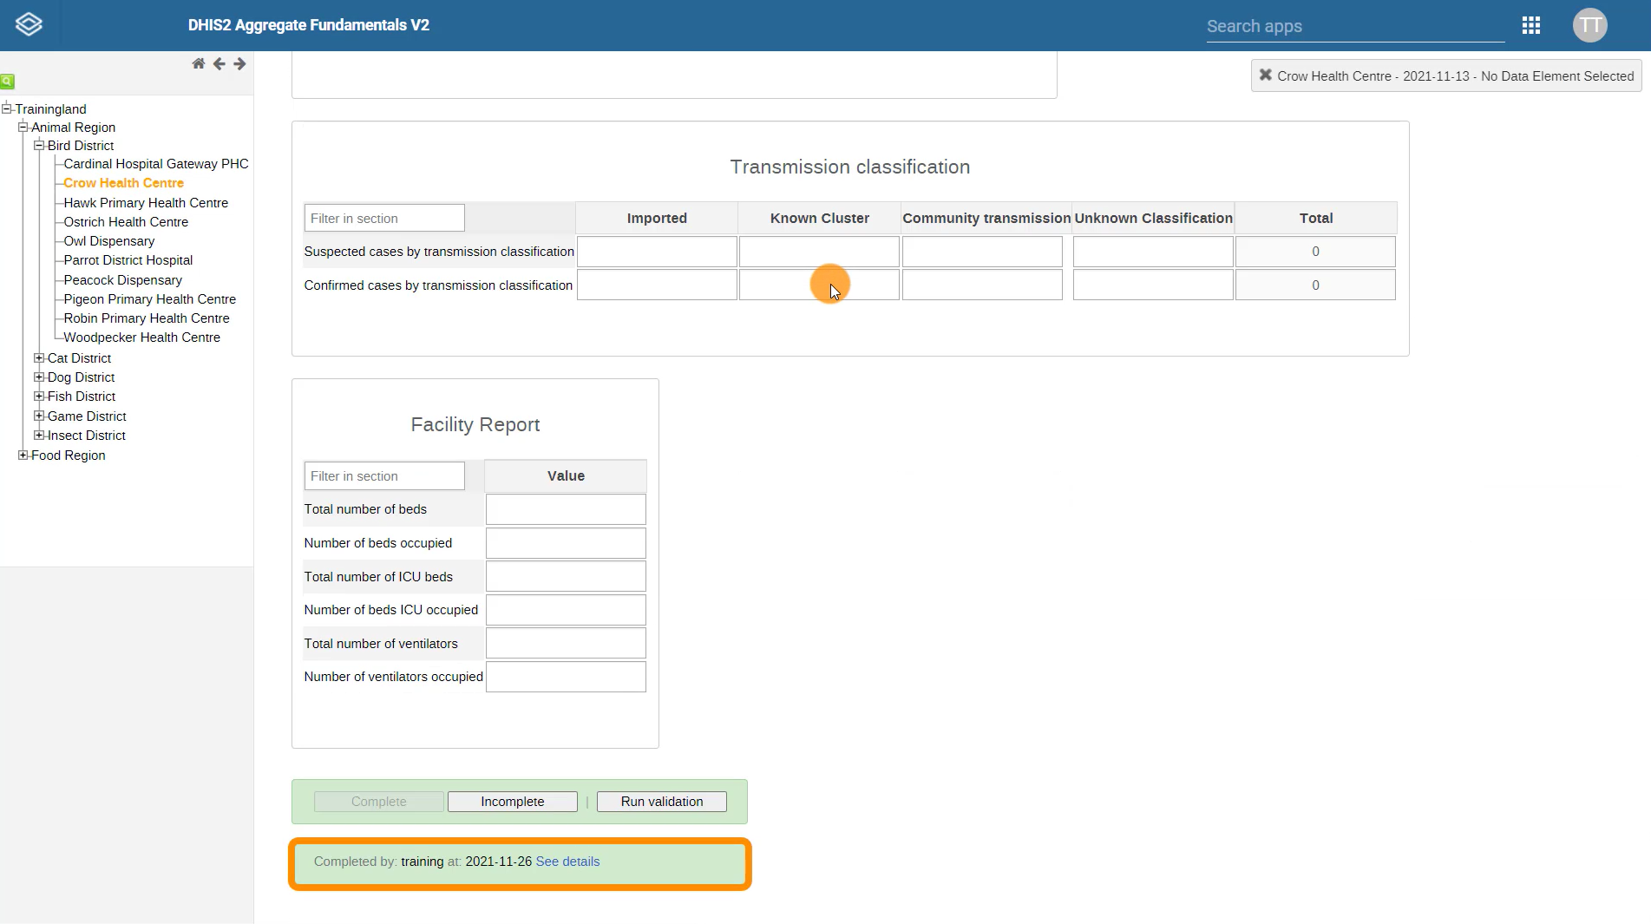
Completeness
Timeliness
Notes:
The timestamp data generated by the complete button is also used to analyze data set completeness and timeliness, which are two dimensions of data quality.

Slide 17
Completeness
Keep track of missing data
Timeliness
Data submitted on time
Notes:
The timestamp data generated by the complete button is also used to analyze data set completeness and timeliness, which are two dimensions of data quality.

Slide 18
Summary
Data entry
Data quality
Value types
#
≥0
/
18
Ensure the data meet predefined logical expressions
Validation rules
Contributes to completeness and timeliness analysis
Complete button
Notes:
In summary, DHIS2 include several tools that can help ensure high-quality data during data capture, including value types for data elements, validation rules that ensure the data entered meet predefined logical expressions, and the complete button, which contributes to the completeness and timeliness analysis and makes it easier to follow up with data entry users to resolve potential data quality issues.

